Slide 1
FRC Robot
Subsystems

Slide 2


Slide 3
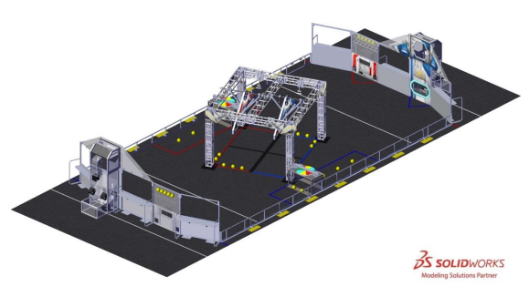
Play field for 2020/2021
https://www.youtube.com/watch?v=gmiYWTmFRVE

Slide 4
Subsystems
Drivetrain
Intake
Conveyor
Turret
Blaster
Gondola
Control Panel
Vision

Slide 5
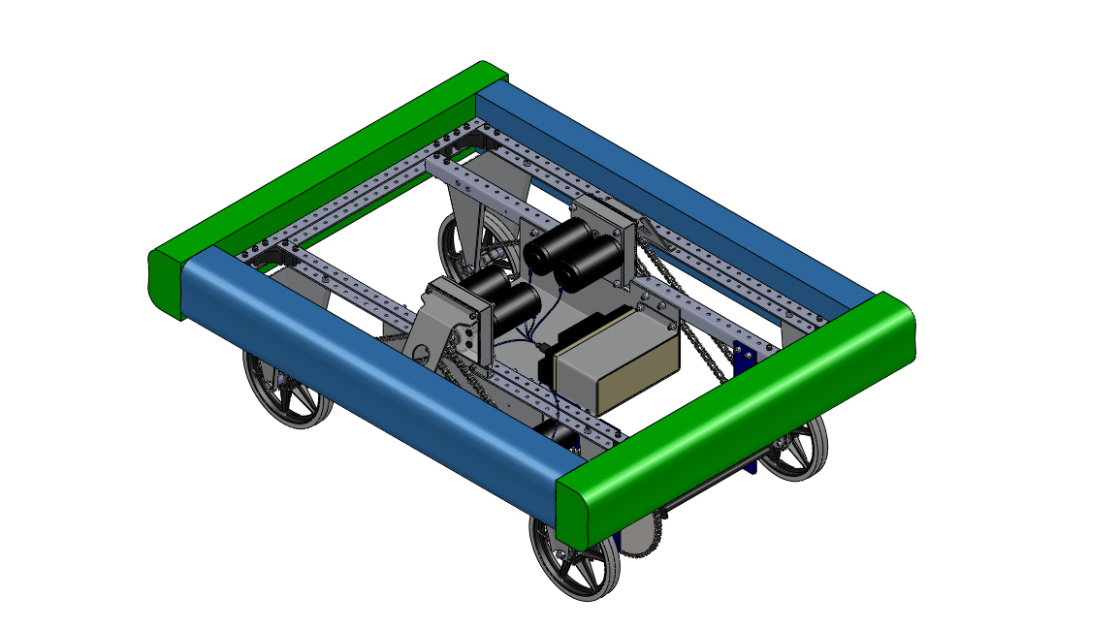
Drivetrain

Slide 6
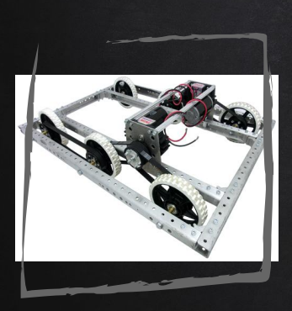
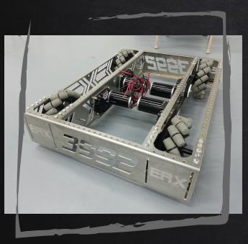
Two Common Types of Drivetrains
Tank drive
Mecanum

Slide 7
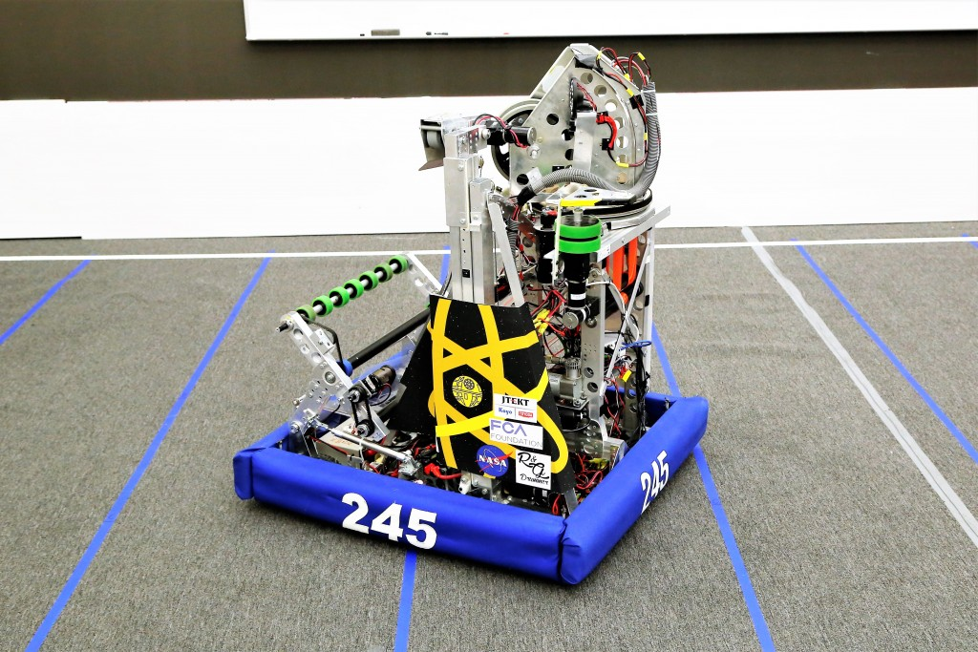
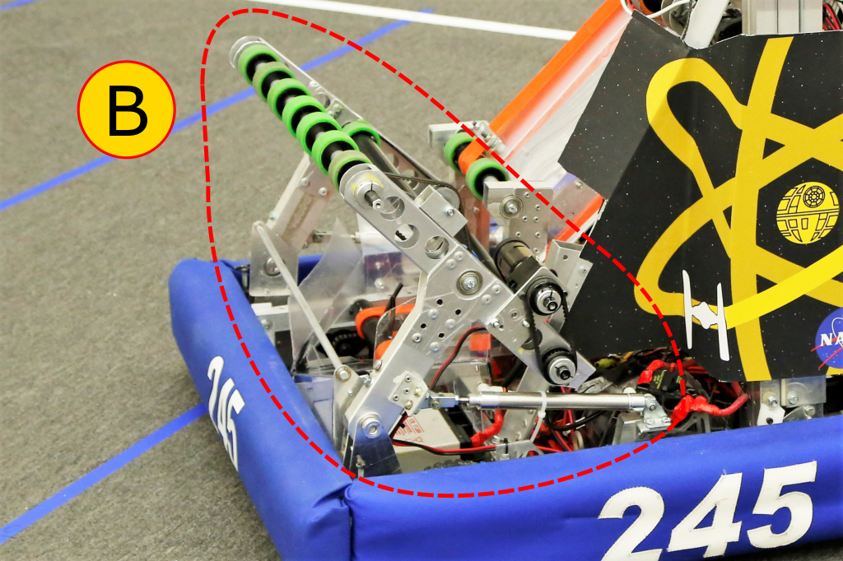
Intake

Slide 8
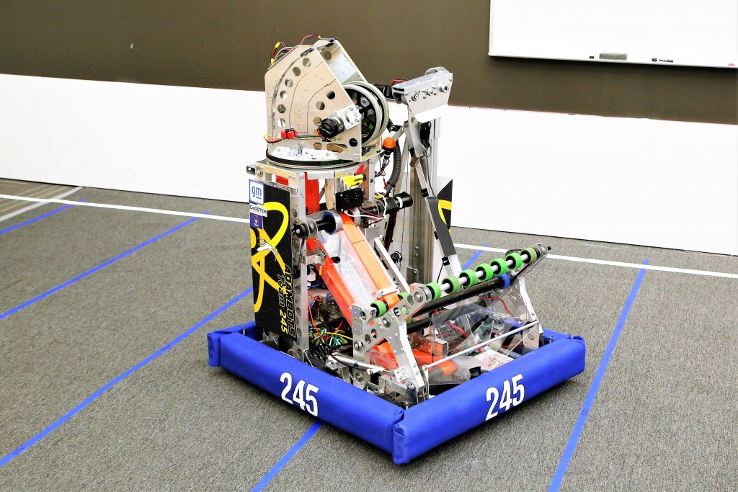
Intake

Slide 9
Turret

Slide 10
Blaster

Slide 11
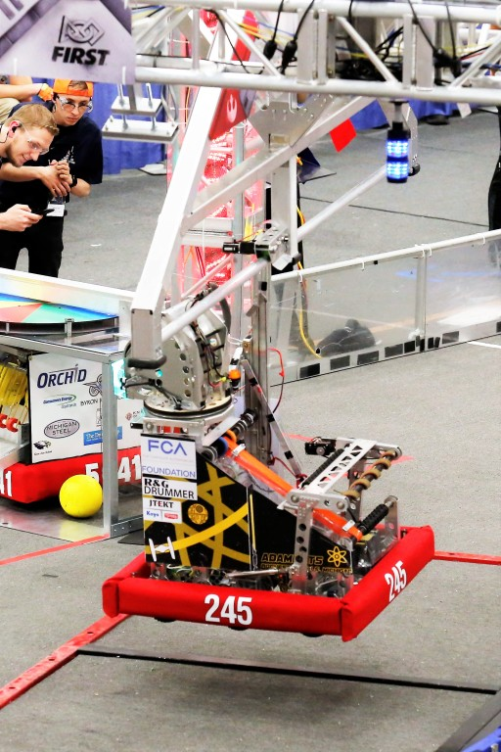
Gondola

Slide 12
Control Panel

Slide 13
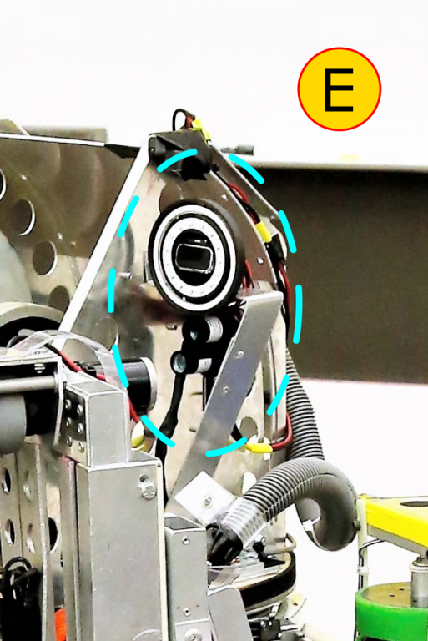
Vision

Slide 14
Controllers and Sensors
Motor Controllers
Gyroscope
LIDAR
Color Sensor
Solenoids
Limit Switch
Photo Eyes

Slide 15
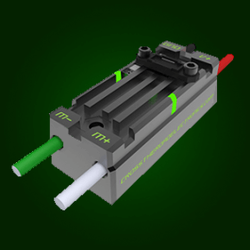
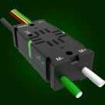
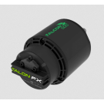
Motor Controllers
CTRE TALON SRX
CTRE VICTOR SPX
CTRE Falcon 500
w/ Talon FX

Slide 16
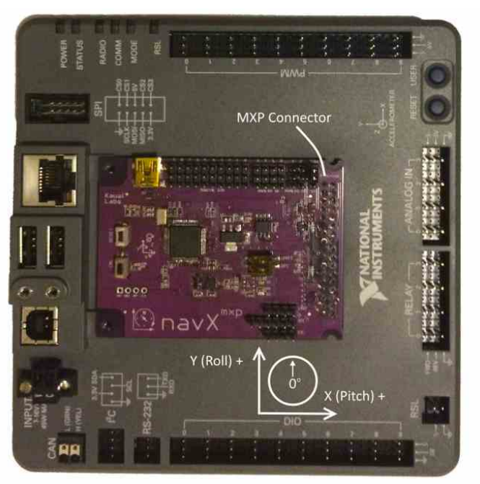
Gyroscope

Slide 17
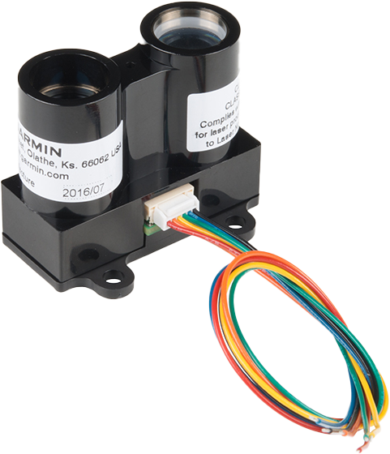
LIDAR

Slide 18
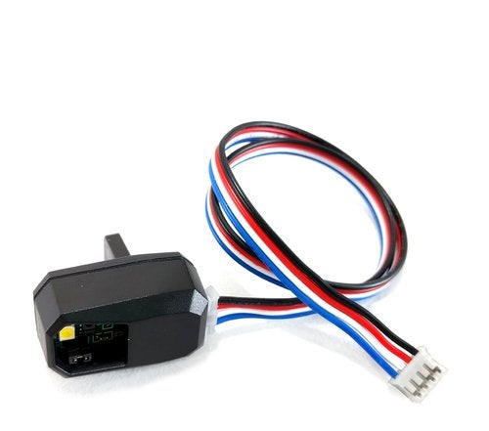
Color Sensor

Slide 19
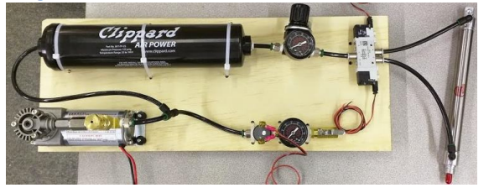
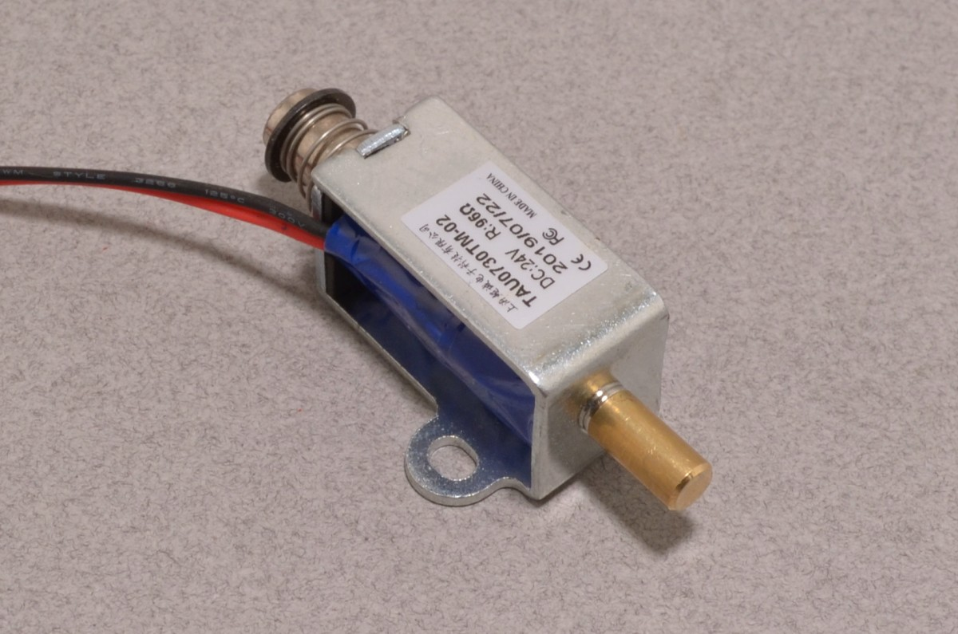
Solenoids

Slide 20
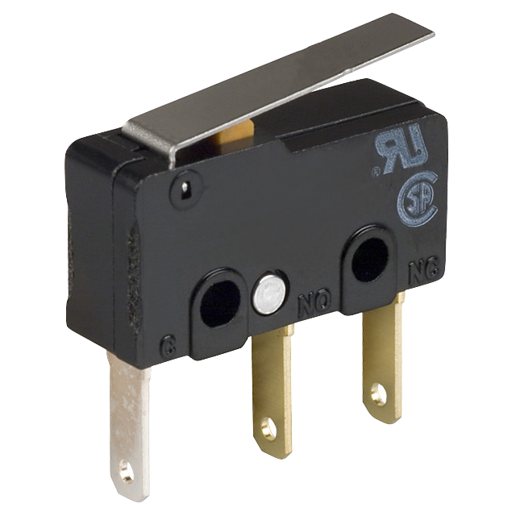
Limit Switch

Slide 21
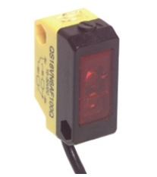
Photo Eye

